Slide 1
Forecasting energy demand Harnessing IOT Data for smart grid Analytics
By
Kotha Aswitha
Challa Yashwitha
Akili Veera Padma Aravind Rao
Godasi Chandrakant

Slide 2
Outline:
Objectives
Motivation
Introduction
Code
Outputs
Conclusions

Slide 3
Objectives:
Seasonal Demand Management: Optimize energy supply strategies to account for higher energy usage in summer and manage reduced demand in winter.
Peak Demand Analysis: Identify peak consumption times daily and seasonally to enhance grid stability and efficiency.
Load Balancing: Use IoT data to balance load more effectively during peak and off-peak hours, reducing stress on the grid.
Energy Efficiency Programs: Develop and promote energy efficiency programs based on analysis of high consumption periods.
Cost Efficiency: Reduce operational costs by aligning energy production with actual consumption patterns.
Enhanced Forecasting Accuracy: Improve the accuracy of demand forecasting models through detailed IoT data analysis.
Sustainable Energy Practices: Encourage sustainable energy usage by providing consumers with data-driven insights into their consumption habits.

Slide 4
Motivation:
Enhance Grid Efficiency: Optimize energy distribution and reduce waste by accurately matching energy supply with anticipated demand.
Reduce Operational Costs: Minimize costs associated with energy production and infrastructure by improving load management.
Support Renewable Integration: Facilitate the integration of renewable energy sources by predicting variations in demand and supply effectively.
Improve Reliability: Prevent outages and maintain consistent energy supply through better anticipation of peak demand periods.
Enable Demand Response: Develop strategies to adjust demand in real-time, enhancing the stability and resilience of the energy grid.
Guide Infrastructure Development: Inform the expansion and upgrading of grid infrastructure based on predicted future energy needs.
Promote Energy Conservation: Encourage efficient energy use through targeted demand management programs and policies.
Meet Regulatory Compliance: Comply with government regulations regarding energy efficiency and reduction of environmental impact.

Slide 5
Introduction:
Seasonal fluctuations greatly influence energy demand; typically, there is higher consumption in summer due to air conditioning and cooling needs, while winter may see less overall energy usage except in regions where heating demands spike.
Using IoT devices, energy utilities can collect and analyze data on electricity usage throughout the year, allowing them to identify trends and make predictions about future energy needs.
Analysis of real-time energy consumption data helps identify peak demand times during the day when energy usage spikes, often in the late afternoon and early evening in residential areas.
This temporal data is essential for demand response strategies, which encourage consumers to use less energy during off-peak hours in order to improve grid efficiency and stability.
By integrating IoT insights into smart grid operations, energy providers can optimize their responses to the dynamic demands, enhancing grid reliability and preventing overloads or energy wastage.
Forecasting models that incorporate this IoT data can be fine-tuned to predict energy requirements more accurately, considering both seasonal variations and daily consumption patterns, thus facilitating better energy management and planning.

Slide 6
Code:
import streamlit as st
import pandas as pd
import numpy as np
from sklearn.ensemble import RandomForestRegressor, GradientBoostingRegressor
from sklearn.linear_model import LinearRegression
import matplotlib.pyplot as plt
@st.cache
def load_data(file_path):
data = pd.read_csv(file_path)
return data
def train_model(algorithm, X_train, y_train):

Slide 7
if algorithm == 'Random Forest':
model = RandomForestRegressor()
elif algorithm == 'Gradient Boosting':
model = GradientBoostingRegressor()
elif algorithm == 'Linear Regression':
model = LinearRegression()
else:
raise ValueError("Invalid algorithm selected")
model.fit(X_train, y_train)
return model
def predict(model, X_test):
return model.predict(X_test)

Slide 8
def main():
st.title('Energy Demand Forecasting with IoT Data')
algorithm = st.sidebar.selectbox('Select Algorithm', ['Random Forest', 'Gradient Boosting', 'Linear Regression'])
file_path = st.sidebar.file_uploader('Upload IoT Data', type=['csv'])
if file_path:
data = load_data(file_path)
data = preprocess_data(data)
st.subheader('Loaded Data')
st.write(data)
X = data.drop(columns=['serial', 'Time_stamp','kVAR'])
y = data['kVAR']

Slide 9
model = train_model(algorithm, X, y)
st.subheader('Predict on Test Dataset')
serial = st.number_input('Serial', value=0)
kWh = st.number_input('kWh', value=0.000 )
kW = st.number_input('kW', value=0.000)
kVARh = st.number_input('kVARh', value=0.000)
if st.button('Predict'):
test_data = pd.DataFrame({'serial': [serial], 'kWh': [kWh], 'kW': [kW], 'kVARh':[kVARh]})
test_X = test_data.drop(columns=['serial’])
prediction = predict(model, test_X)
st.subheader('Prediction’)
st.write(prediction)

Slide 10
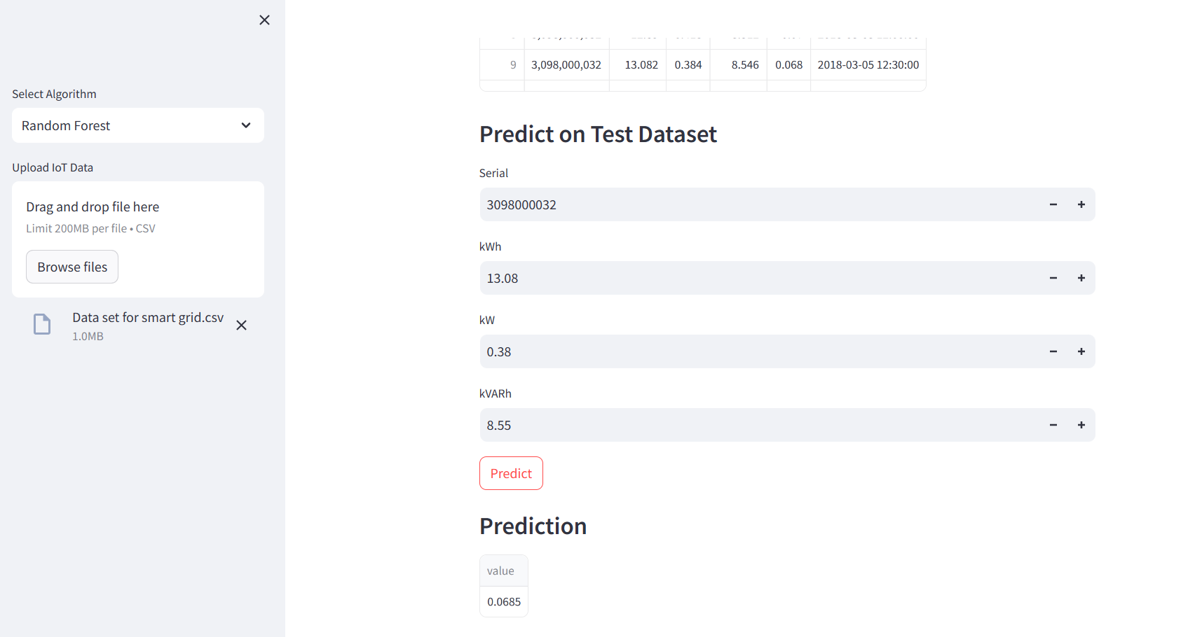
Output 1:Random Forest

Slide 11
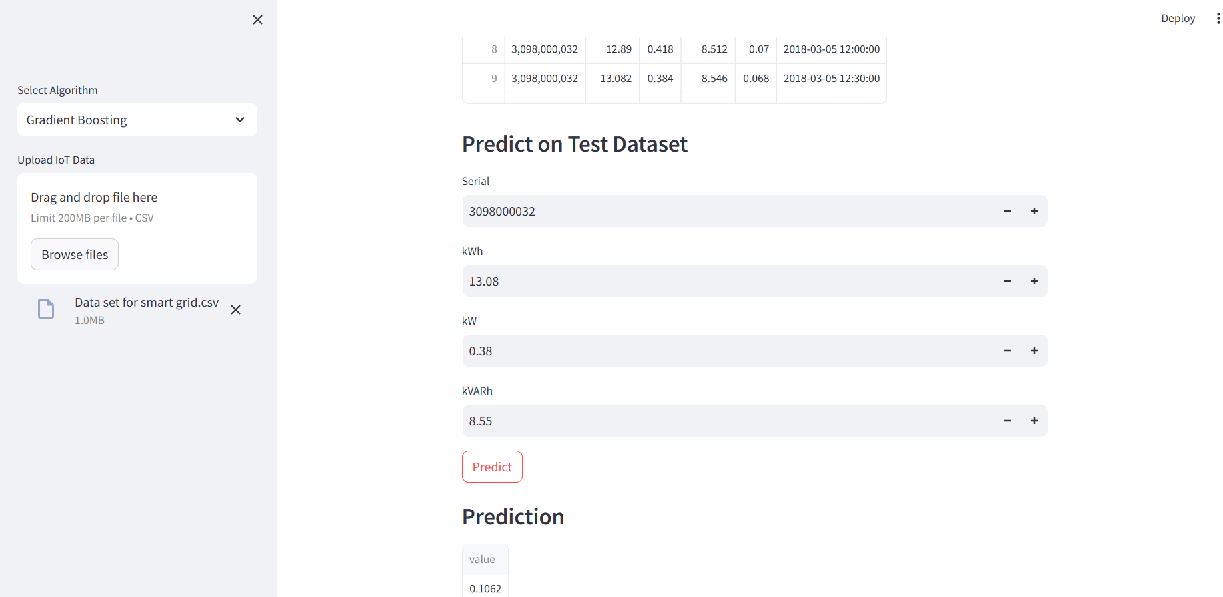
Output 2:Gradient boosting

Slide 12
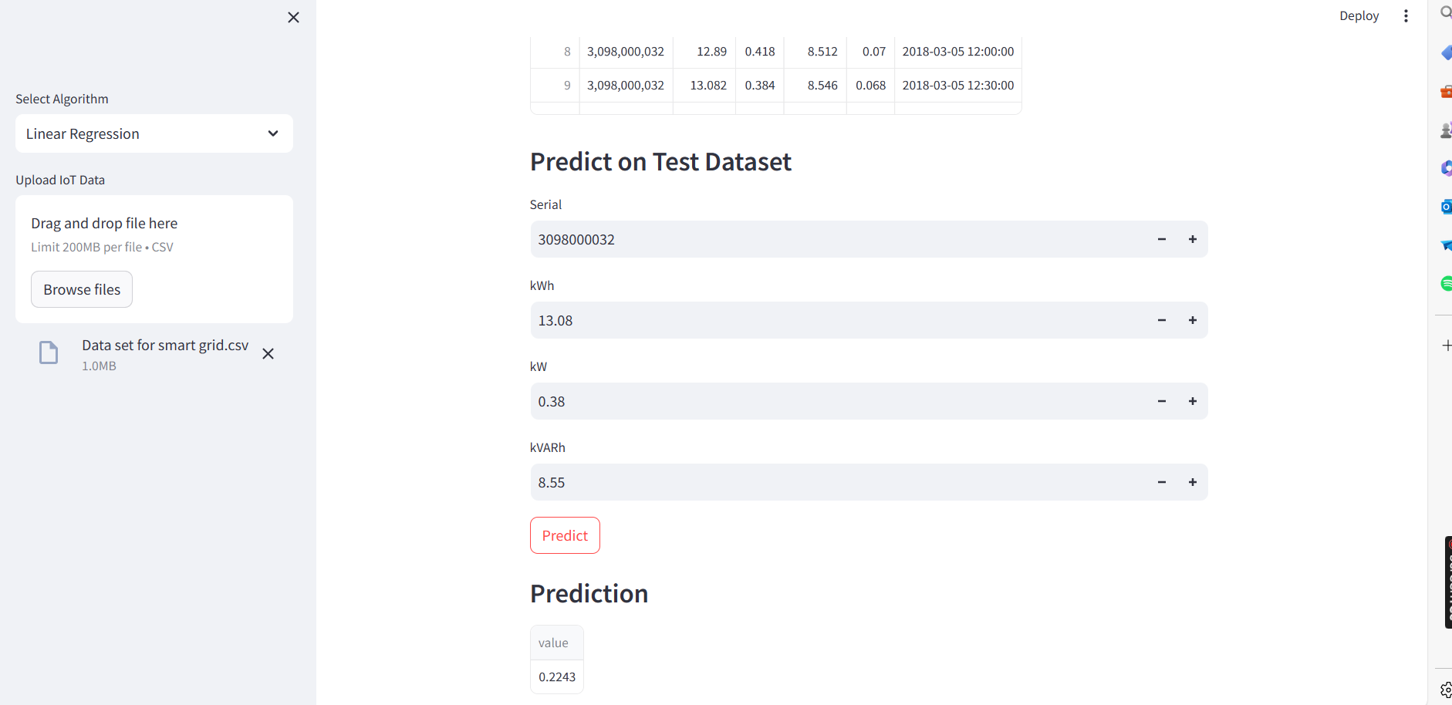
Output 3:Linear Regression

Slide 13
Conclusions:
With the help of IoT-enabled data analytics , tools can improve grid efficiency and operations by gaining helpful knowledge about energy demand forecasting.
Accurate demand forecasting supports the integration of renewable energy sources, contributing to a more sustainable energy infrastructure.
Engaging consumers through personalized insights encourages energy-saving behaviors and promotes active participation in demand-side management.
Predictive maintenance strategies improve grid reliability and reduce maintenance costs by anticipating equipment failures and optimizing maintenance schedules.
Leveraging IoT data analytics for smart grid applications not only meets regulatory requirements but also fosters innovation and drives the transition towards a more resilient and sustainable energy future.

Slide 14
Any Questions/Discussions ???

Slide 15
Thank You !!!

